Slide 1
Autonomous Wheelchair using Structured Light
Michael Hodgson,
John Charlesworth,
Adham Beyki and
Mahdi Naddaf

Slide 2
Contents
Aims
Structured Light
Original 2D Investigation
3D Point Cloud
Point Cloud Library
Voxel Grid
Floor Removal
Clear Direction
Pathfinding
Other Work
Demo
Questions

Slide 3
Aims
To provide obstacle detection and avoidance using structured light

Slide 4
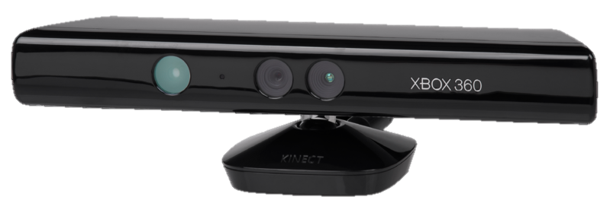
Structured Light (Kinect)
We are using the Microsoft Kinect
Structured light 3D sensor
Works by:
Projecting a pattern (IR laser grid)
Observing how this is distorted when viewed from another view point (IR CMOS sensor)
Laser
IR Sensor

Slide 5
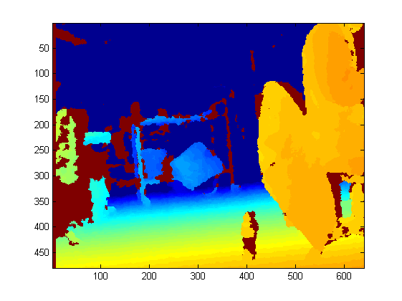
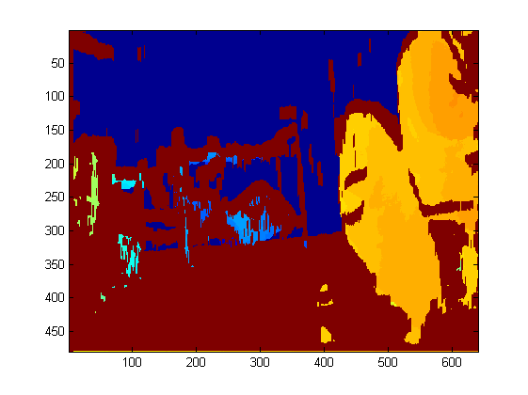
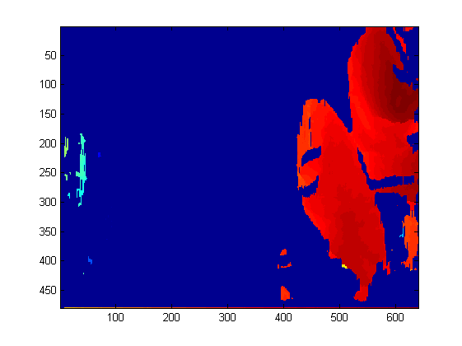
Original 2D Investigation
Data captured by screenshot, then microsoft SDK and finally openNI viewer
Transferred to MATLAB for processing:
Floor removal
Depth thresholding
Raw depth data
Floor removed
Depth thresholded

Slide 6
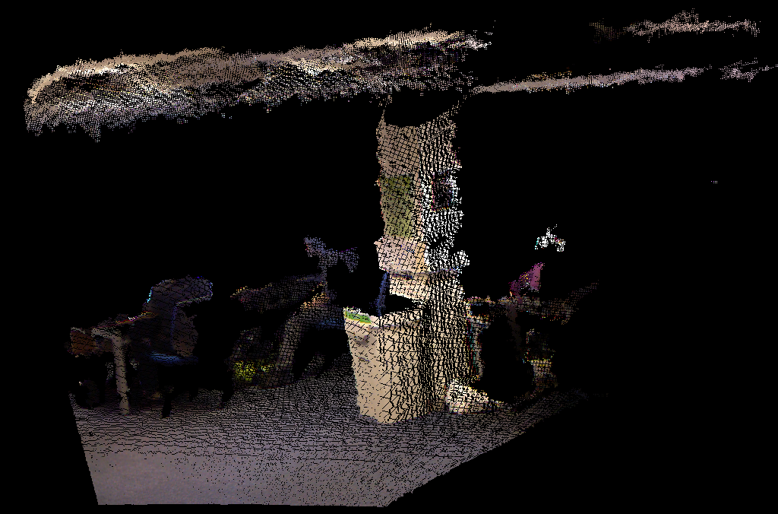
3D Point Cloud
The structured light sensor generates a point cloud

Slide 7

3D Point Cloud – Point Cloud Library
The Point Cloud Library (PCL) was used in this project
The PCL is a C++ library for manipulating point clouds
It provides access to a wide range of functions in areas such as filtering, segmentation and visualisation.
http://pointclouds.org/

Slide 8
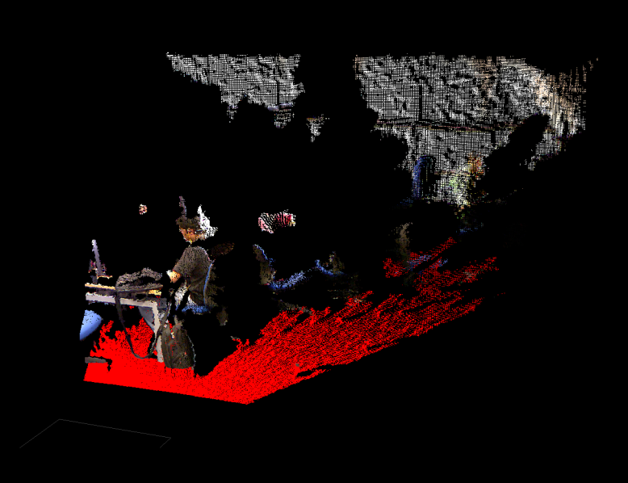
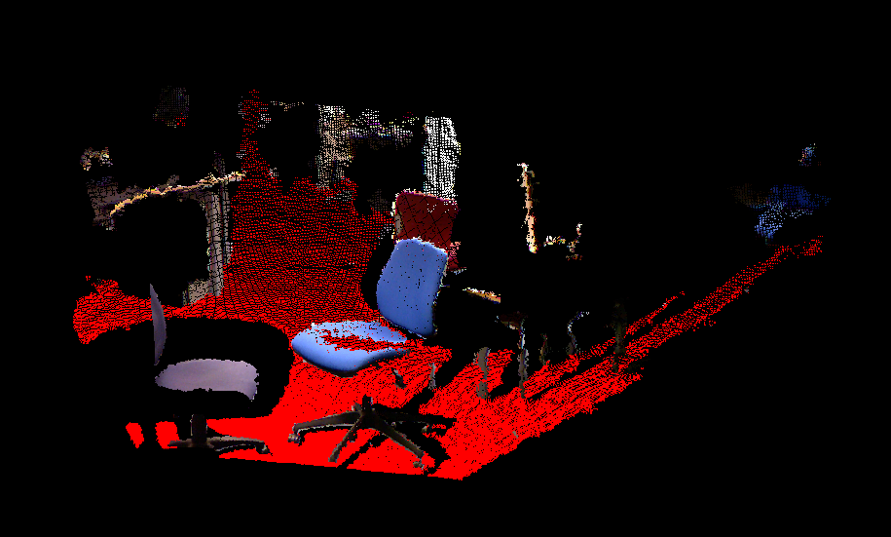
3D Point Cloud – Floor Detection
Different methods were used to detect the floor
Based on comparison with planes
First Method: manually sweep through planes (slow)
Second Method: manually remove ceiling and use RANSAC algorithm
Notes:
Top image brute force, bottom RANSAC

Slide 9
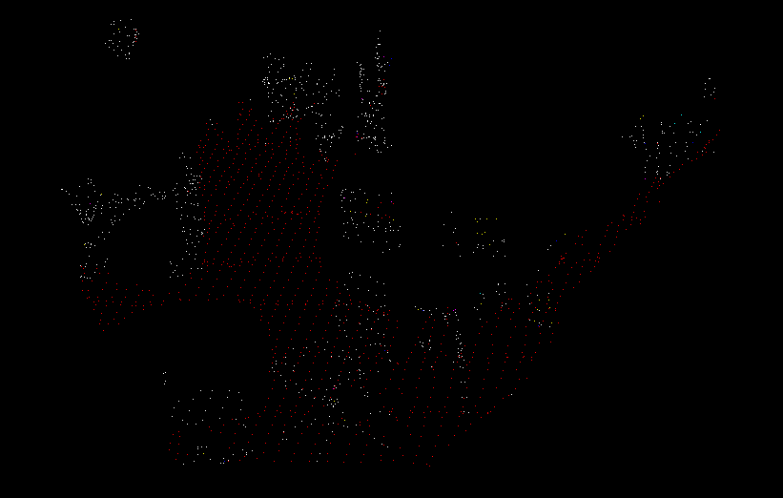
3D Point Cloud - Voxel Grid Downsampling
Reasons we downsampled in a uniform grid:
Speed (too many points)
Larger point density close to Kinect
PCL’s built in filter creates a 3D voxel grid over the point cloud data
Downsamples using centroids of all points in voxel^{[1]}
[1] http://docs.pointclouds.org/trunk/classpcl_1_1_voxel_grid.html#_details

Slide 10
For Your Information - RANSAC

Slide 11
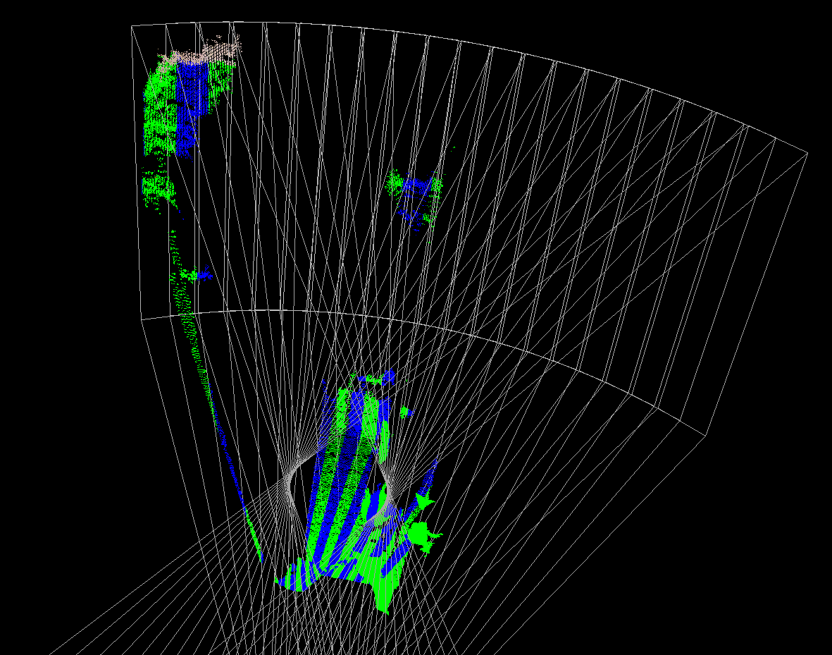
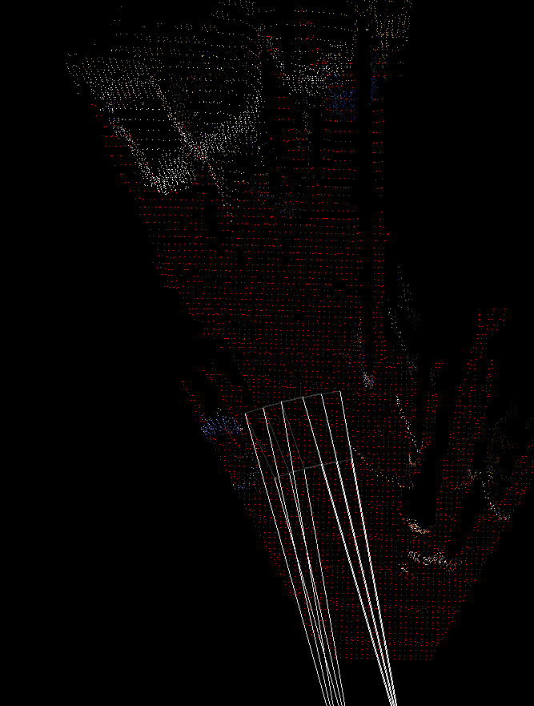
3D Point Cloud – Clear Direction
Calculation of clear directions
Method:
Box is swept across scene
Floor points and obstacle points within box counted
Boxes with floor points above a threshold and obstacle points below a threshold are marked as clear and displayed
Box length variable

Slide 12
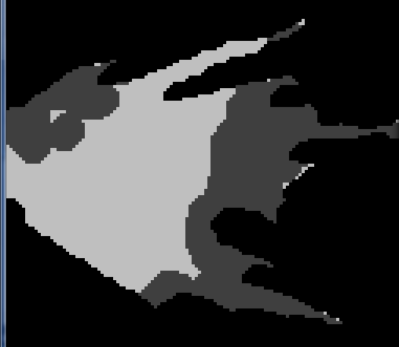
3D Point Cloud – Occupancy Map
A 2D Occupancy map was constructed
Method:
Floor captured, dilated and marked as passable
Obstacle points captured, dilated and marked as impassable
Dilation to account for wheelchair width

Slide 13
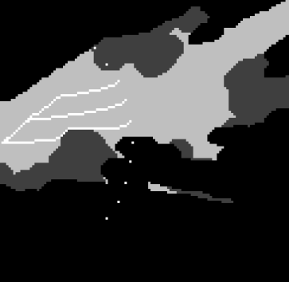
3D Point Cloud - Pathfinding
Using occupancy map
Pathfinding done using the A* algorithm
Single start point, multiple radial finish points
Finish point distance variable

Slide 14
For Your Information – A* (A Star) Search Algorithm
Faster extension of Dijkstra's algorithm
Space represented as 2D array with each cell either passable or impassable
Uses a distance-plus-cost function to determine which nodes to search next:
Function of cost from start cell to current cell
Plus estimated distance from current cell to finish
http://en.wikipedia.org/wiki/File:Astar_progress_animation.gif

Slide 15
3D Point Clouds – Other Work

Slide 16

Demonstration

Slide 17

Any Questions?

